Slide 1
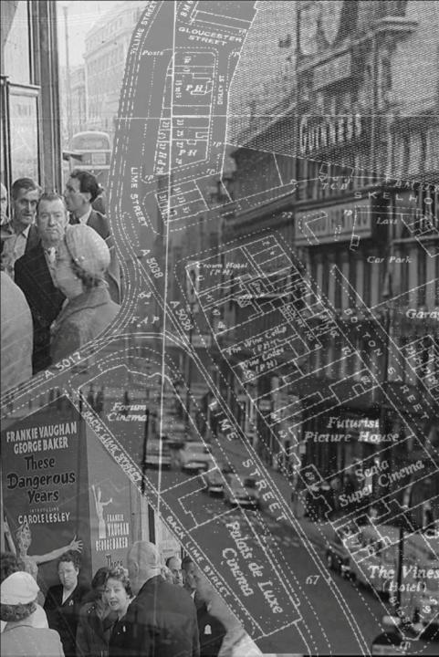
Locating the City in Film | Navigating the Archive City
www.liminoids.com
Dr Les Roberts
University of Liverpool
les.roberts@liverpool.ac.uk

Slide 2
Locating the City in Film | Navigating the Archive City
Where is the city in film?
Rethinking archival film practices through the prism of spatiality
Archive cities in practice
Defining / Mapping / Dis-locating
the object of study
Epistemological (re)framing
Archive City I : Liverpool
Archive City II : Bologna

Slide 3
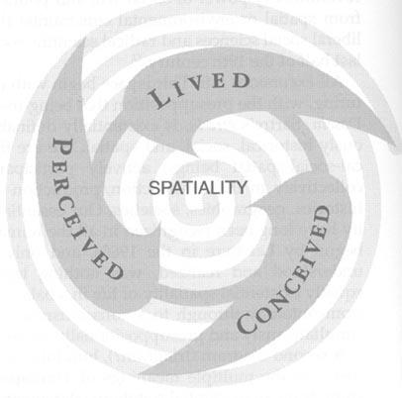
Locating the City in Film | Navigating the Archive City
Reel vs real? (....really?)
Are ‘reel’ geographies of film any less real than ‘real’ geographies of film?
Realism describes ‘a mobility that moves…from cultural text to lived actuality and back again. Realism is the convergence of the textual and actual’ (Ben Highmore, Cityscapes, 2005: 22).
Social and cultural production of space (Lefebvre)
Space open and relational (Massey)
Spatial Dialectics (source: Soja 1996)

Slide 4
Locating the City in Film | Navigating the Archive City
So where is the city in film?
What exactly is cinematic geography?
cinematic cartography?
cinematic archaeology?
‘the cautious probing of the spade in the dark loam’ of urban archival space
(Walter Benjamin, 1999: 576)
‘the field of cultural studies is riddled with the idea of “mapping”’
(Tom Conley, 2009: 131).
urban
urban
urban
SURVEYING
NAVIGATING
MAPPING
EXCAVATING

Slide 5
Locating the City in Film | Navigating the Archive City
The Archive City
Metaphor of the ‘city as archive’
Michael Sheringham – rethink the city as a library: ‘an aggregation of reading material’
‘....the archival, in its materiality, its layeredness, its endless transformations, is a dimension that cities have in common, and that we access by consenting to let go of our familiar reference points in personal and collective time and space’ (Sheringham in Beaumont and Dart, Restless Cities, 2010: 12, 14).
The archive city refers to both the city excavated from forms of archival imagery – the city ‘in’ the archive – and the idea of the city itself ‘as’ an archive: a space of everyday habiting and memory.
Historiographically, the metaphor of the archive shifts the temporal cartography of the city in film away from a surface diachrony of historical narrative towards temporal verticality and depth.
‘Deep memory’ / layering / archaeologies of memory / GIS spatial logic
Mapping across spatialities of film, place and memory.

Slide 6
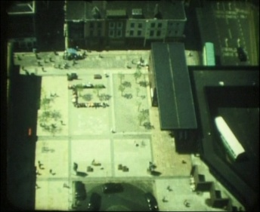
Locating the City in Film | Navigating the Archive City
Where is this city in film?
The Pool of Life
A ‘day in the life’ of Williamson Square in Liverpool city centre.
(Angus Tilston, Swan Cine Club, 9.5mm, 1974-6)
https://www.youtube.com/watch?v=nYxStXl3wZU

Slide 7
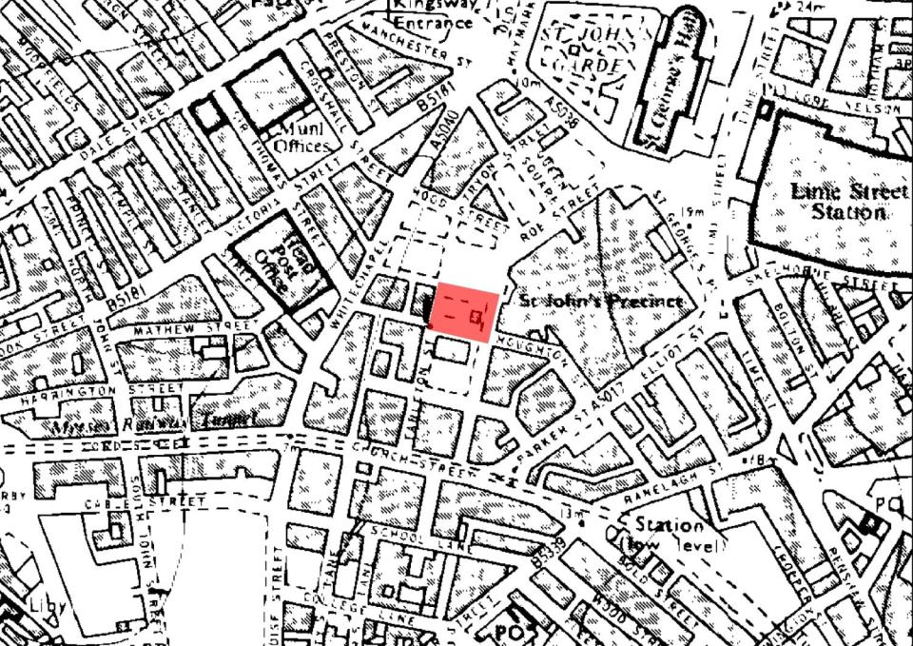
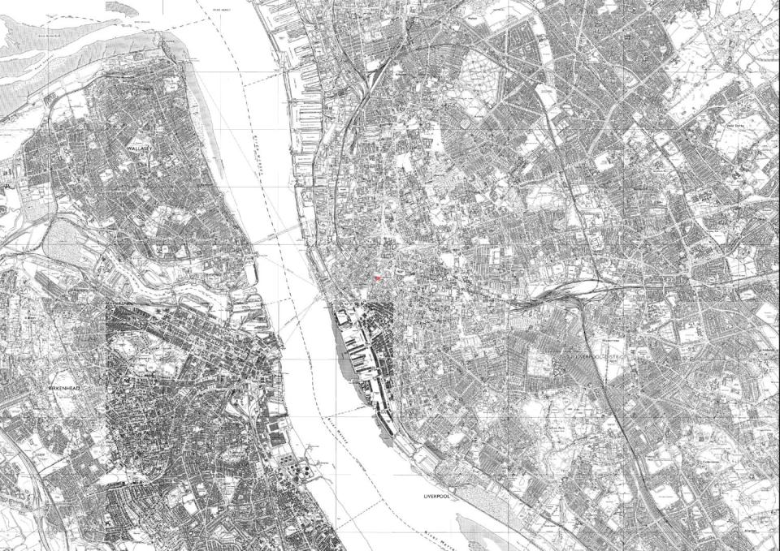
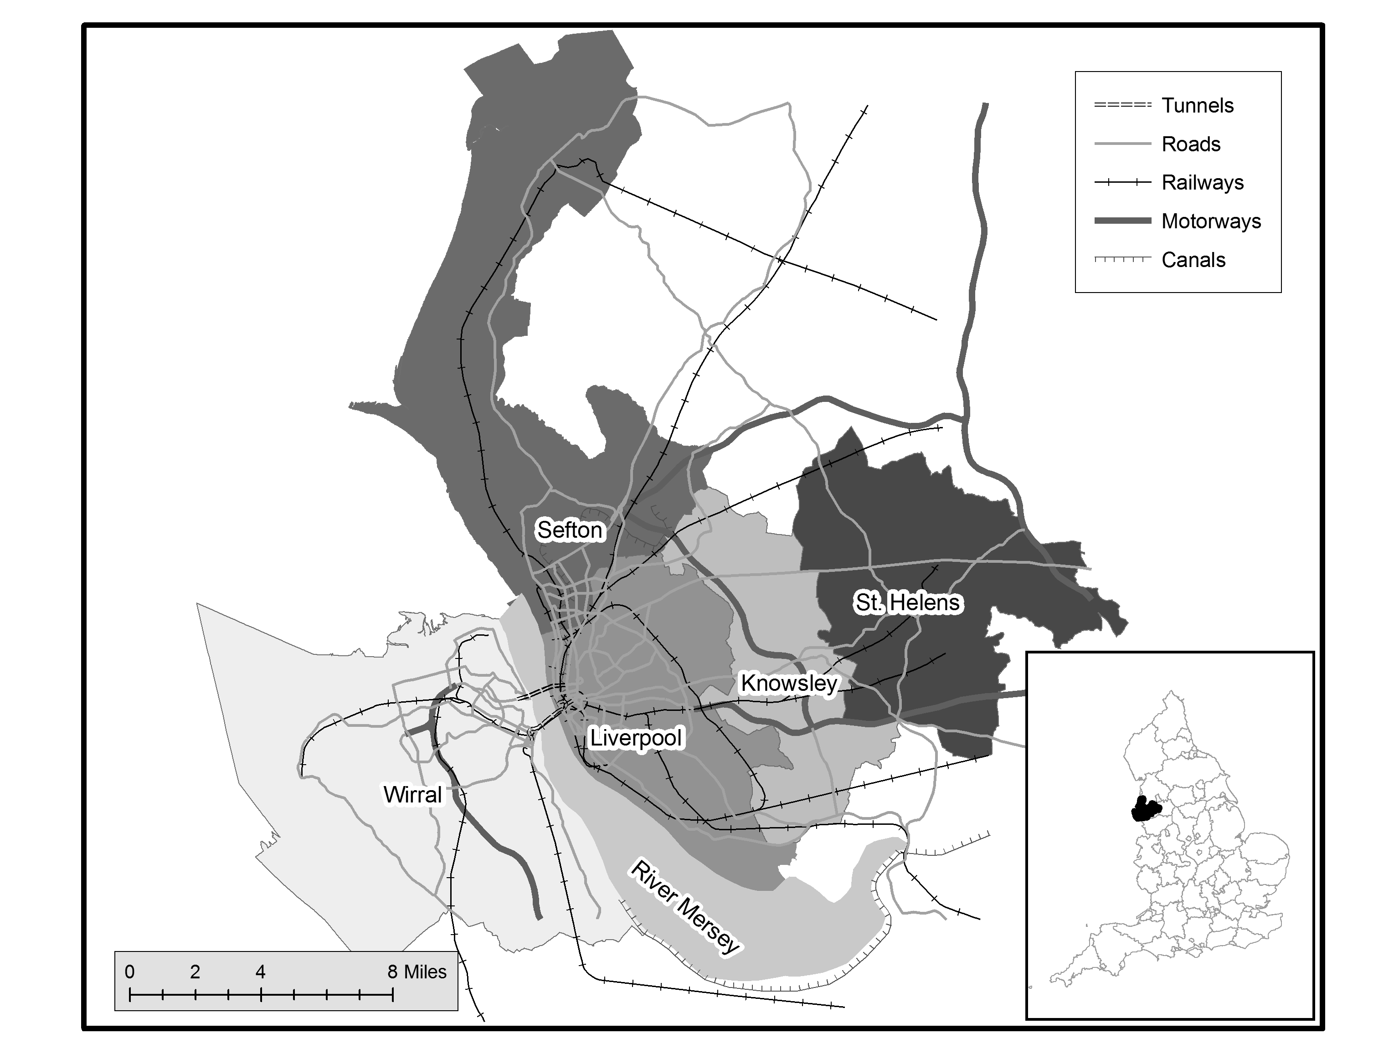
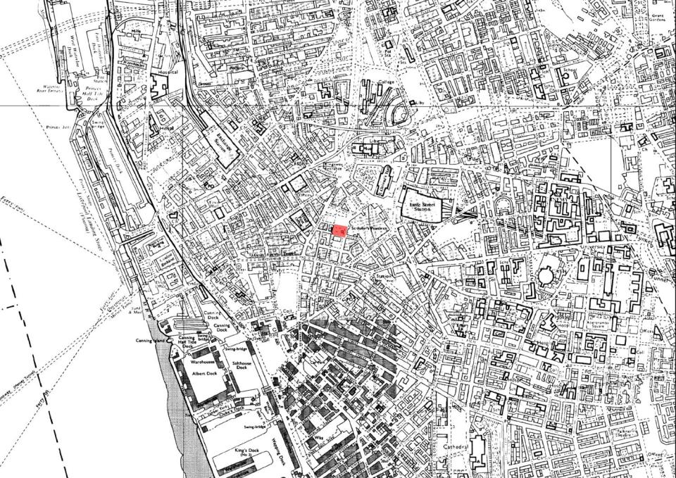
Locating the City in Film | Navigating the Archive City
Williamson Square

Slide 8
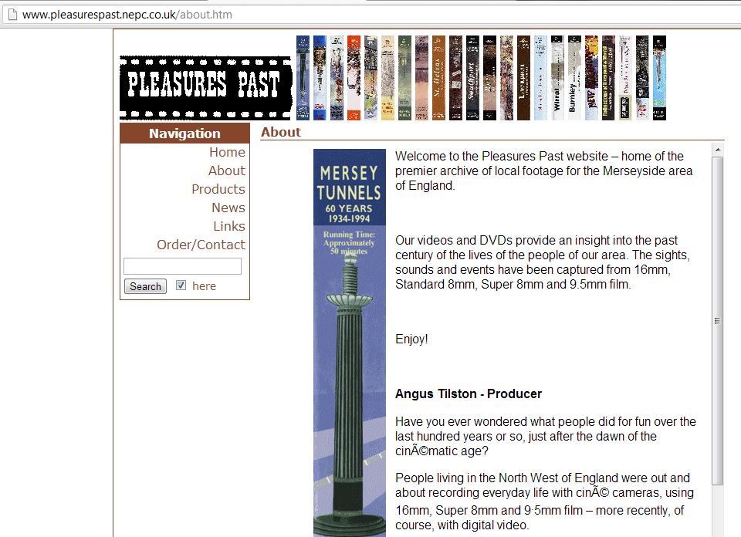
Locating the City in Film | Navigating the Archive City

Slide 9
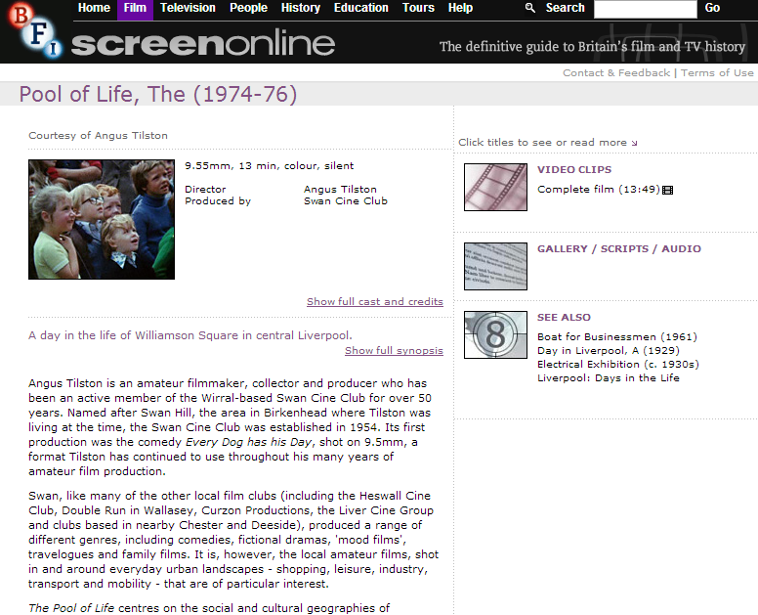
Locating the City in Film | Navigating the Archive City

Slide 10
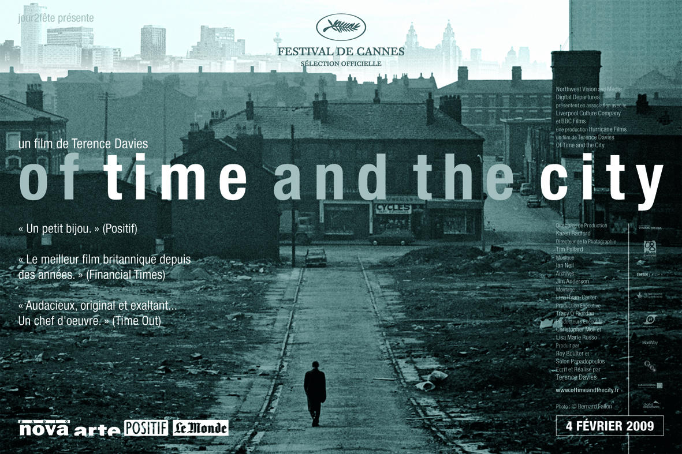
Locating the City in Film | Navigating the Archive City

Slide 11
Locating the City in Film | Navigating the Archive City

Slide 12
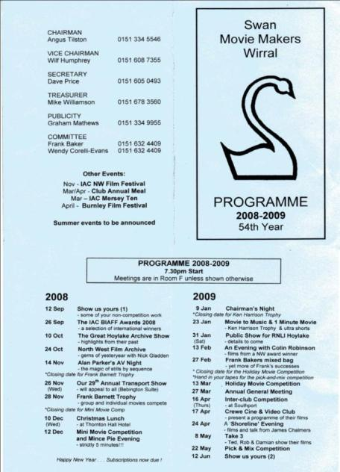
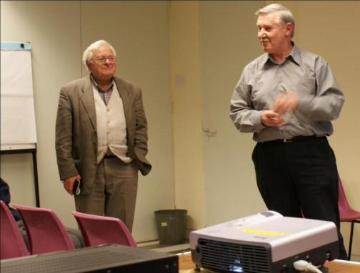
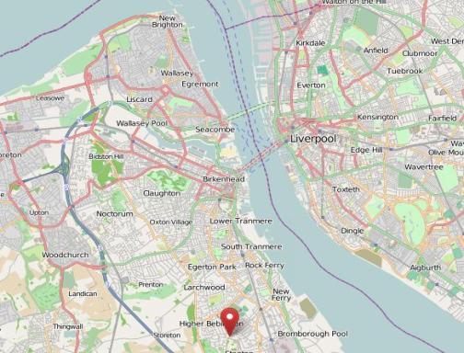
Locating the City in Film | Navigating the Archive City

Slide 13
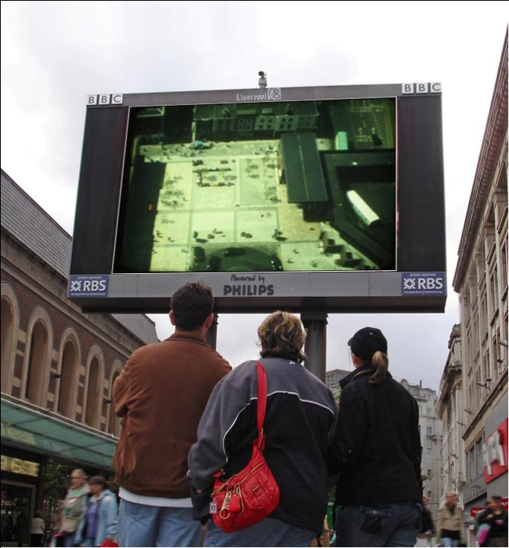
Locating the City in Film | Navigating the Archive City

Slide 14
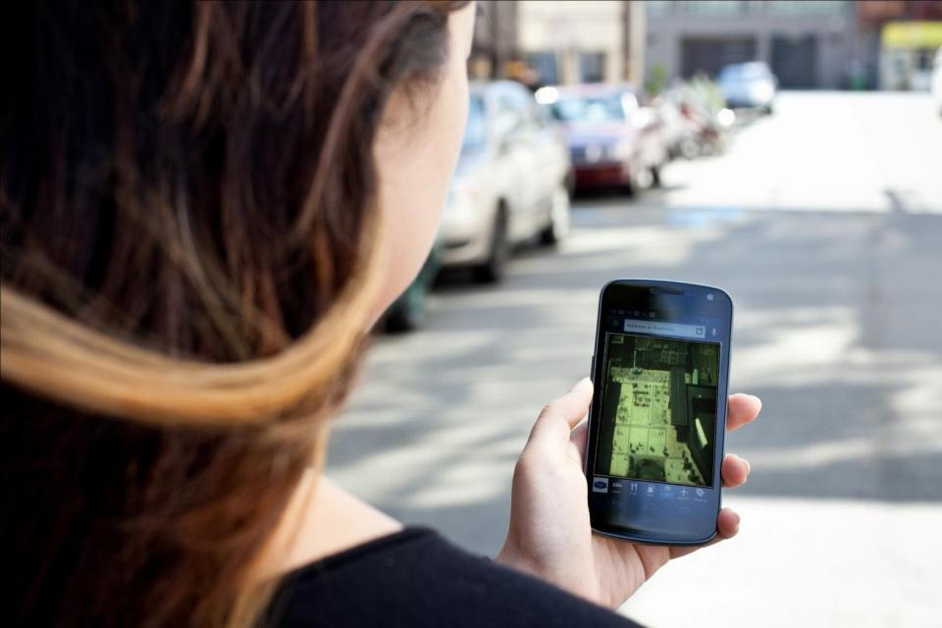
Locating the City in Film | Navigating the Archive City

Slide 15
Silent Witness (Swan Cine Club, Super 8mm, 1981)
https://www.youtube.com/watch?v=pdaTR_eryPE

Slide 16
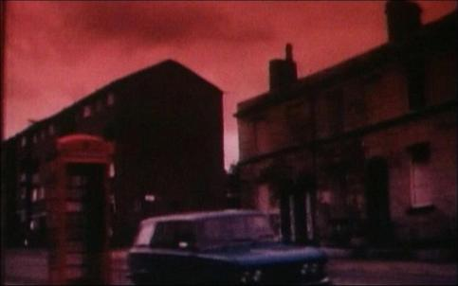
Locating the City in Film | Navigating the Archive City
Mapping across...
The archive city creates possibilities for:
mapping across different spatialities
mapping across different temporal geographies
mapping across different city rhythms
mapping across different cities
mapping across post-industrial urban spaces
Liverpool location - still from The Last of England,
(Derek Jarman, 1987)

Slide 17
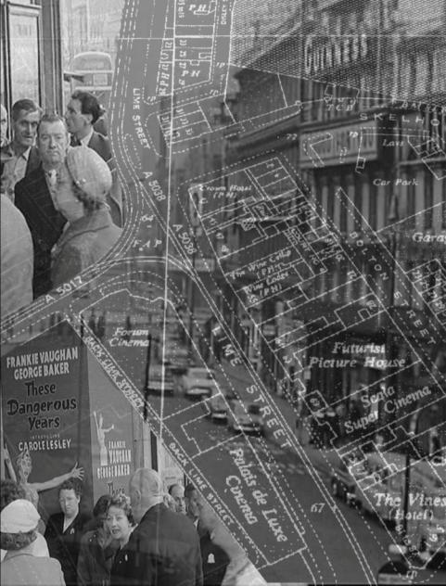
Locating the City in Film | Navigating the Archive City
ARCHIVE CITY I: LIVERPOOL

Slide 18
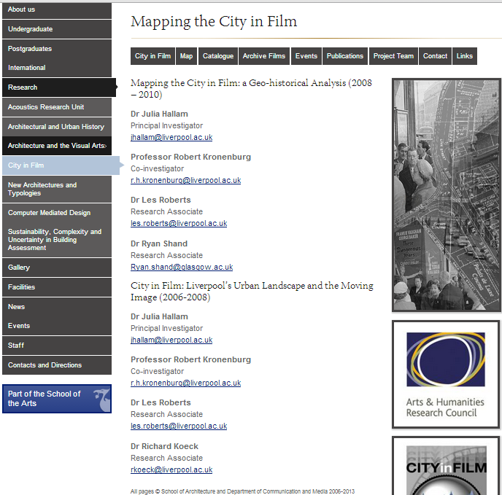
Locating the City in Film | Navigating the Archive City

Slide 19
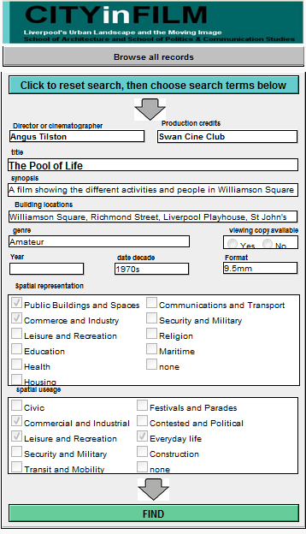
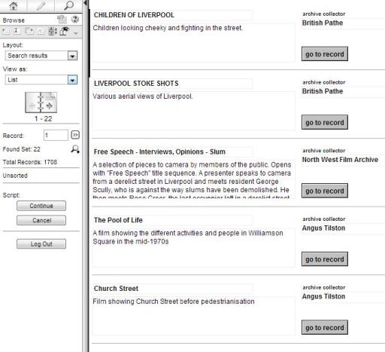
Locating the City in Film | Navigating the Archive City
Search results page [Variables searched: Spatial Usage = ‘Everyday Life’ + Decade = ‘1970s’]
City in Film catalogue search interface

Slide 20
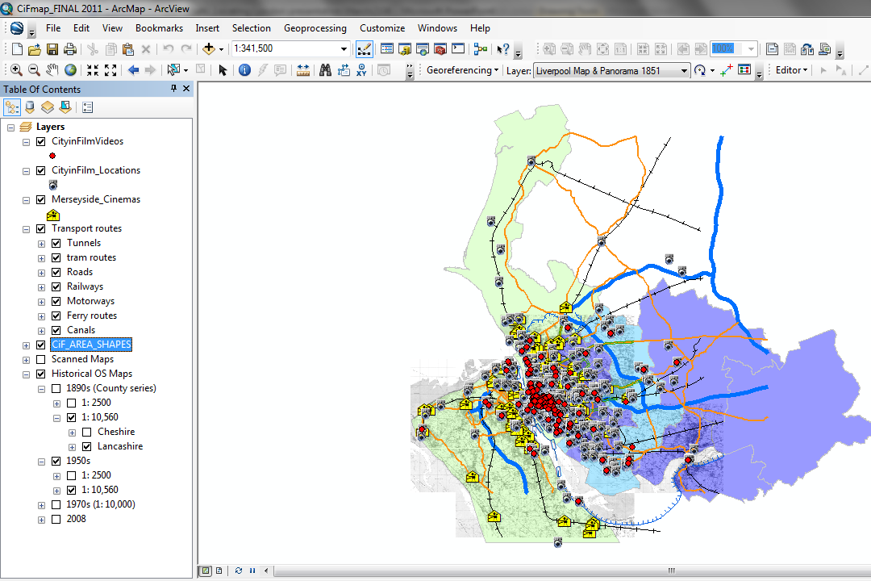
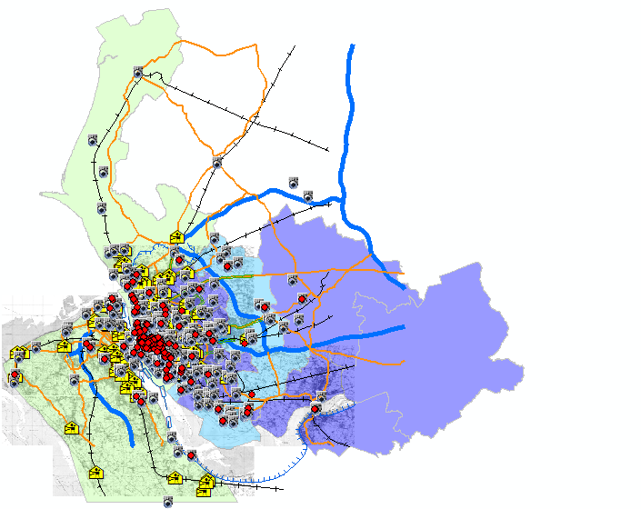
Locating the City in Film | Navigating the Archive City

Slide 21
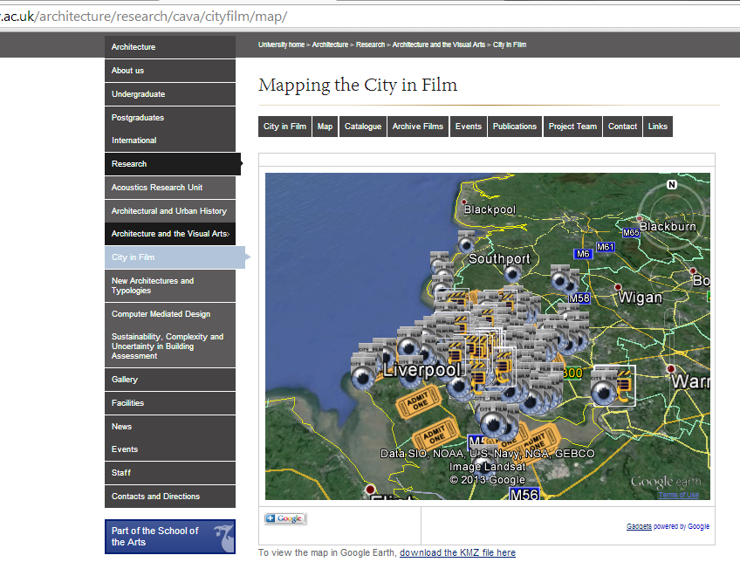
Locating the City in Film | Navigating the Archive City

Slide 22
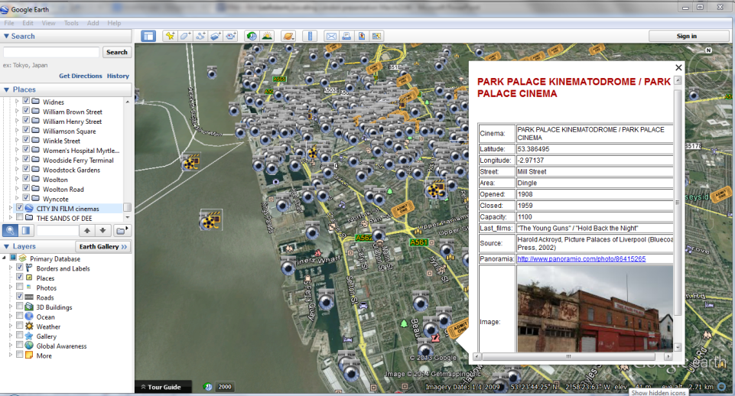
Locating the City in Film | Navigating the Archive City

Slide 23
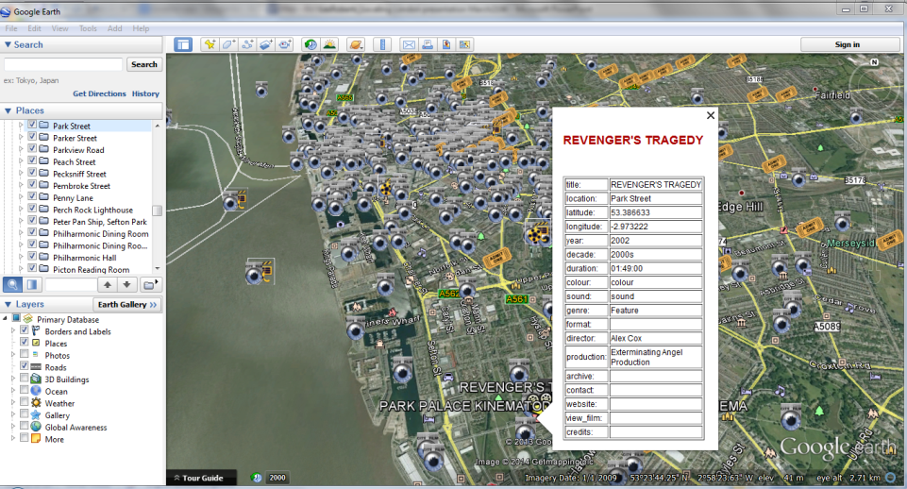
Locating the City in Film | Navigating the Archive City

Slide 24
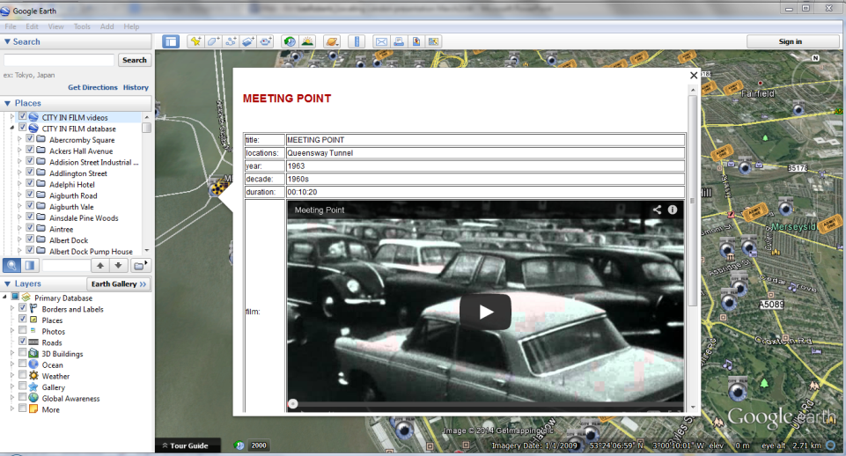
Locating the City in Film | Navigating the Archive City

Slide 25
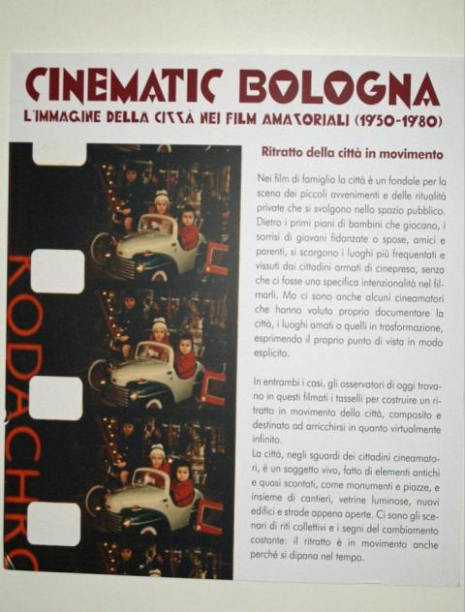
Locating the City in Film | Navigating the Archive City
ARCHIVE CITY II: BOLOGNA

Slide 26
Locating the City in Film | Navigating the Archive City
http://www.memoriadelleimmagini.it/homemovies/
ARCHIVE CITY II: BOLOGNA
Cinematic Bologna was an exhibition and series of workshops held at the Urban Centre located in the Salaborsa in Bologna city centre between November 2012 and January 2013.
Drawing on a wide range of amateur films shot in Bologna from 1950 to 1980, the exhibition was organised by Associazione Home Movies, the National Family Film Archive, also based in the city.
The archive was founded in 2002 by Paolo Simoni and Karianne Fiorini.
Home Movies has built up a collection of some 16,000 family films/home movies on a range of small-gauge formats, establishing Italy’s de facto national amateur film archive and one of the largest collections anywhere dedicated to the recovery, conservation and enhancement of a nation’s amateur film heritage.
Framed exclusively through the lens of amateur film, Cinematic Bologna spans three decades of films depict scenes of everyday life in and around the city.

Slide 27
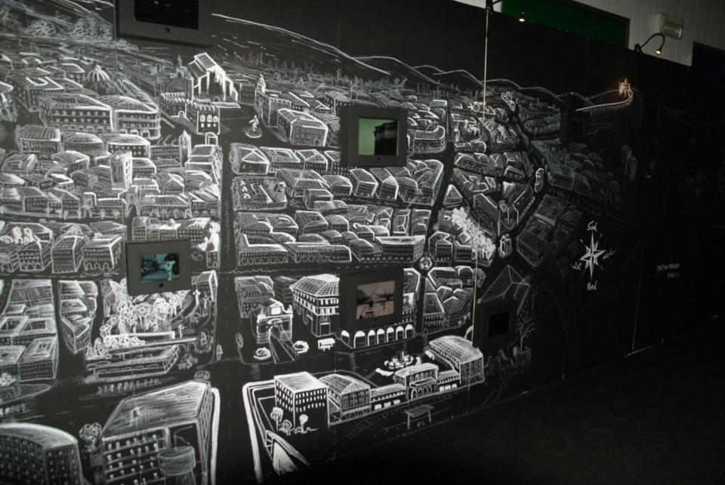
Locating the City in Film | Navigating the Archive City

Slide 28
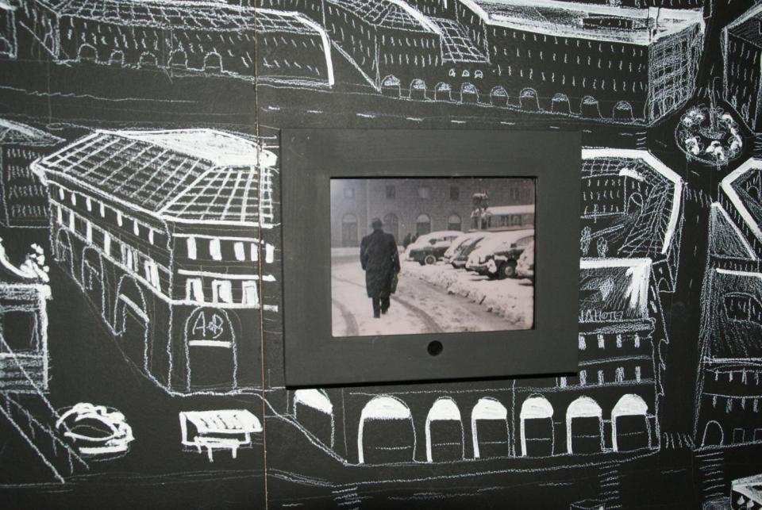
Locating the City in Film | Navigating the Archive City

Slide 29
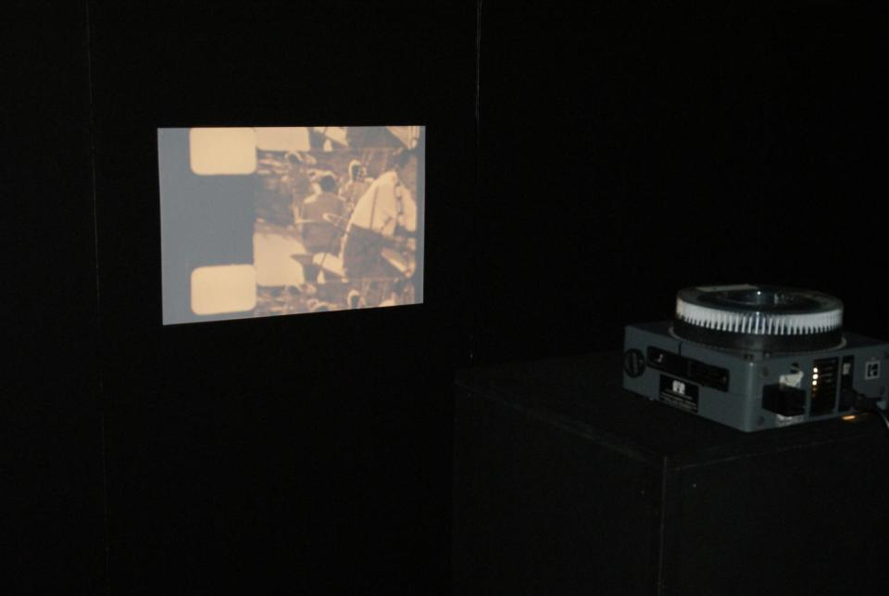
Locating the City in Film | Navigating the Archive City

Slide 30
Locating the City in Film | Navigating the Archive City

Slide 31
Locating the City in Film | Navigating the Archive City
Conclusions
Locating the city in film:
is about locating – or dislocating – oneself in or across disciplinary spaces.
is about locating and bringing into play the multiple spatialities that constellate around the city and the moving image.
is about redefining or ‘re-mapping’ what it is we might understand by the term archive – archival practices through the prism of spatiality.
is about rethinking the scope and range of what archival film practices are or could be.
- - -
Towards a ‘new empiricism’? (Roberts and Hallam 2014)

Slide 32
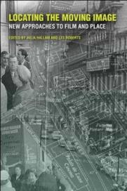
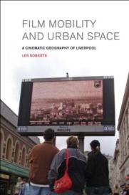
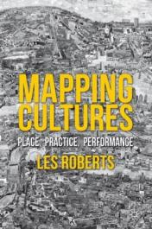
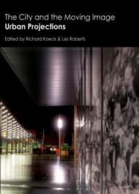
Locating the City in Film | Navigating the Archive City
www.liminoids.com
Locating the Moving Image:
New Approaches to Film and Place
Julia Hallam & Les Roberts (eds)
2014
Film, Mobility and Urban Space:
A Cinematic Geography of Liverpool
Les Roberts 2012
Mapping Cultures:
Place, Practice, Performance
Les Roberts (ed) 2012
The City and the Moving Image: Urban Projections
Richard Koeck & Les Roberts (eds) 2012

