Slide 1
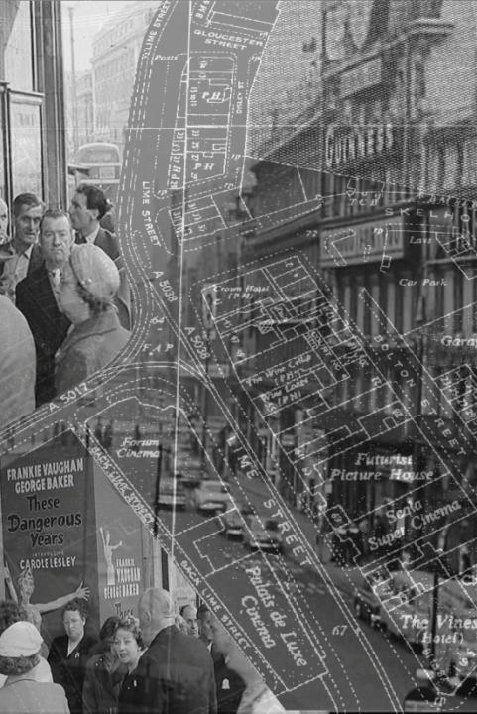
SPATIAL ANTHROPOLOGY AND THE ARCHIVE CITY: LOCATING URBAN CULTURAL MEMORY
Les Roberts
School of the Arts
University of Liverpool
les.roberts@liverpool.ac.uk
liminoids.com
THE ARCHIVE CITY
LOCATING THE ARCHIVE CITY
SPATIAL HUMANITIES & THE ARCHIVE CITY
SPATIAL ANTHROPOLOGY & THE ARCHIVE CITY
NETWORKING THE ARCHIVE CITY

Slide 2
THE ARCHIVE CITY

Slide 3
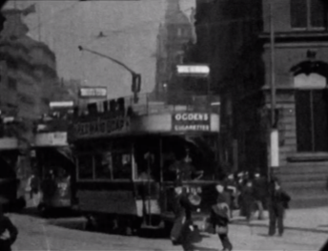
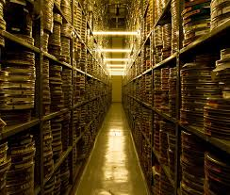
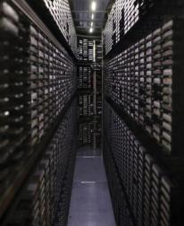
THE ARCHIVE CITY
What is the ‘archive city’?
What is the ‘archive’ in the digital age?
Where is the ‘archive’ in the digital age?
How might archival film practices ‘articulate an historiography of radical memory’? (Russell 1999)
Mitchell & Kenyon ‘Liverpool as seen from the front of an electric car’ (1901)

Slide 4
THE ARCHIVE CITY
The city ‘in’ the archive The city ‘as’ an archive
ARCHIVE CITY – ‘....the archival, in its materiality, its layeredness, its endless transformations, is a dimension that cities have in common, and that we access by consenting to let go of our familiar reference points in personal and collective time and space’. (Michael Sheringham, in Beaumont & Dart (eds) Restless Cities, 2010)
MOBILE DATA STORAGE – cultural memory as digital memory; YouTube as an archive or ‘digital wunderkammer’ (‘cabinet of curiosities’) (Robert Gehl, 2009)
LOCATIVE MEDIA/DIGITAL+SMART CITIES – site-specificity and digital cultures; digital mapping/GIS; augmented spatial reality; digital urban infrastructure.
ARCHAEOLOGY OF MEMORY – deep memory, palimpsest, layering of urban memory
ARCHIVEOLOGY (Catherine Russell, 2017) – ‘the reuse, recycling, appropriation, and borrowing of archival material that filmmakers have been doing for decades… As this practice has expanded in digital media culture, it has arguably acquired the potential to construct critical cultural histories’

Slide 5
THE ARCHIVE CITY
The city ‘in’ the archive The city ‘as’ an archive
SPATIAL BRICOLAGE – ‘gleaning’ the city through film; archive film practices as an assemblage of place and memory; archives as digital ‘collage’.
DEEP MAPPING – multi-media cartography; performance; GIS/geospatial computing; big data; database as symbolic form (Manovich); ethnographic/autoethnographic; thick description; spatial stories (Bodenhamer et al 2015; Roberts 2015-16)
PSYCHOGEOGRAPHY – site-specific interventions; performativity and memory; going against the grain of the dominant spatial ordering; the past as spatial critique (Patrick Keiller) – consenting to let go of our familiar reference points in personal and collective time and space; defamiliarisation of everyday urban landscapes
SPATIAL ANTHROPOLOGY – social/cultural production and consumption of space (more on this a little later)
LIVED SPACE of memory (Lefebvre 1991) / reflexivity / (auto)ethnography / immersion

Slide 6
LOCATING THE ARCHIVE CITY

Slide 7
LOCATING THE ARCHIVE CITY
Selection of key literature on film and space/ film and the city – circa 2008/9
Aitken, S and L Zonn (eds) (1994) Place, Power, Situation and Spectacle: A Geography of Film.
AlSayyad, N. (2006). Cinematic Urbanism: A History of the Modern From Reel to Real.
Barber, S. (2002) Projected Cities: Cinema and Urban Space.
Brunsdon, C. (2007). London in Cinema: the Cinematic City Since 1945.
Clarke, DB (ed.) (1997) The Cinematic City.
Conley, T. (2007) Cartographic Cinema.
Dimendberg, E. (2004). Film Noir and the Spaces of Modernity.
Lefebvre, M. (ed.) (2006) Landscape and Film.
Lukinbeal, C.and L. Zonn (eds) (2004) ‘Special Issue: Cinematic Geographies’, GeoJournal 59 (4).
Mennel, B. (2008) Cities and Cinema.
Shiel, M. and T. Fitzmaurice (eds) (2001) Cinema and the City: Film and Urban Societies in a Global Context.
Shiel, M. and T. Fitzmaurice (eds) (2003) Screening the City.
A list compiled in 2019 would be considerably longer and far more interdisciplinary

Slide 8
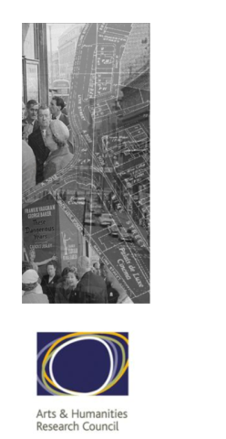
LOCATING THE ARCHIVE CITY
City in Film: Liverpool’s Urban Landscape and the Moving Image
(UK Arts and Humanities Research Council, 2006-2008)
Interdisciplinarity project – collaboration between architecture and media/communication studies
Collation of information on archive film of Liverpool from 1897 to 1980s
Non-fiction – newsreels, documentaries, amateur film, municipal film, etc.
Archival research – identifying spatial/geographical/location information in archival footage
Development of database/online catalogue

Slide 9
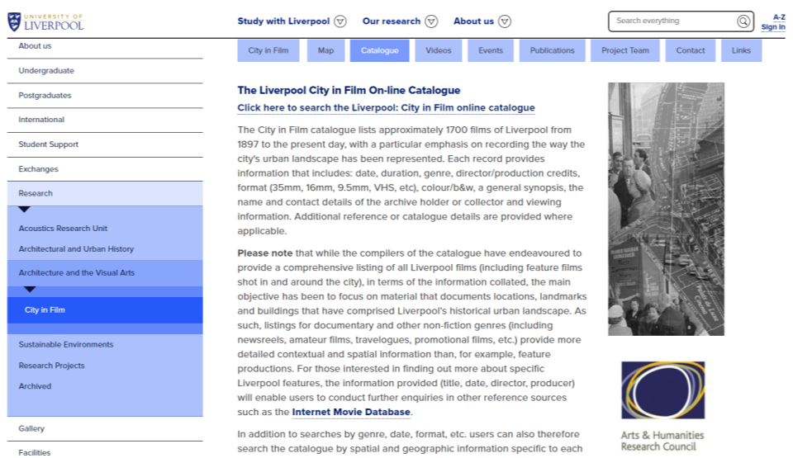
LOCATING THE ARCHIVE CITY
City in Film: Liverpool’s Urban Landscape and the Moving Image
(UK Arts and Humanities Research Council, 2006-2008)

Slide 10
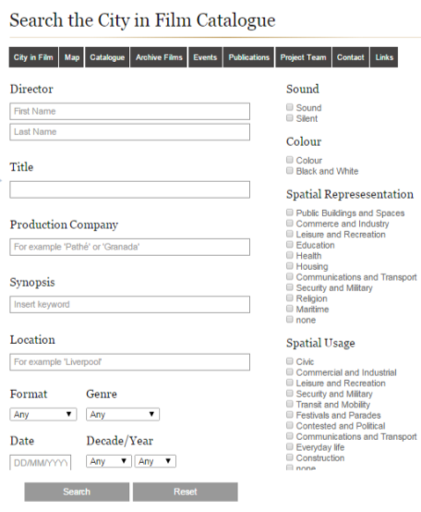
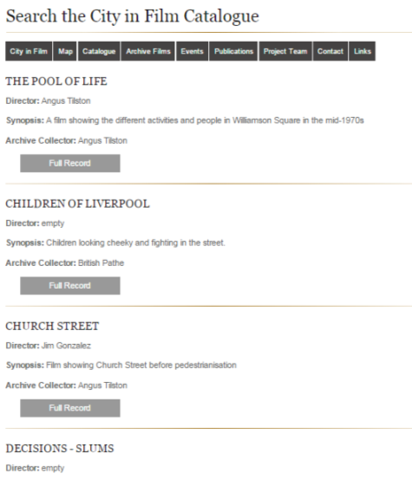
LOCATING THE ARCHIVE CITY
City in Film: Liverpool’s Urban Landscape and the Moving Image
(UK Arts and Humanities Research Council, 2006-2008)
Architectural
Search results page [Variables: Spatial Usage = ‘Everyday Life’ + Decade = ‘1970s’]
Anthropological

Slide 11
LOCATING THE ARCHIVE CITY
Mapping the City in Film: a Geo-Historical Analysis
(UK Arts and Humanities Research Council, 2008-2010)
www.liverpool.ac.uk/communication-and-media/research/groups/cityfilm/map/
Interdisciplinarity project – collaboration between architecture and media/communication studies, but also urban/civic design, computer science, geography and cartography, literary studies, popular music studies, visual arts
This encompasses what we might now think of as spatial humanities
Mapping of City in Film data using GIS software
Ethnographic/qualitative research with amateur filmmakers in Liverpool/Merseyside area
Development of online film map

Slide 12
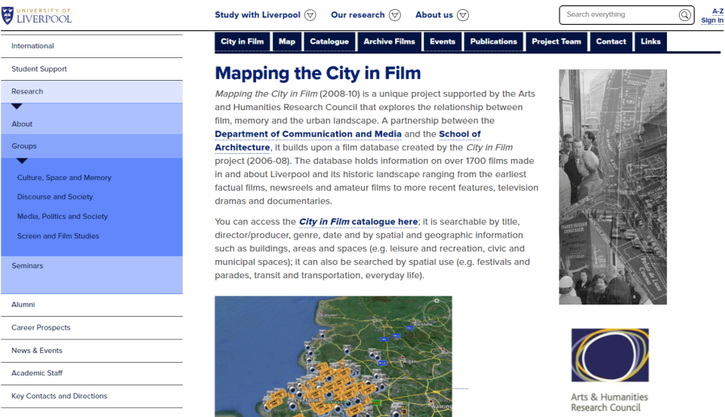
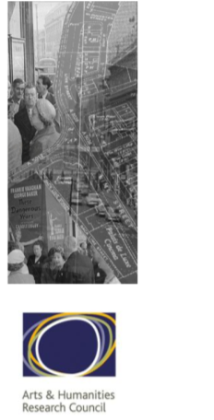
LOCATING THE ARCHIVE CITY
Mapping the City in Film: a Geo-Historical Analysis
(UK Arts and Humanities Research Council, 2008-2010)

Slide 13
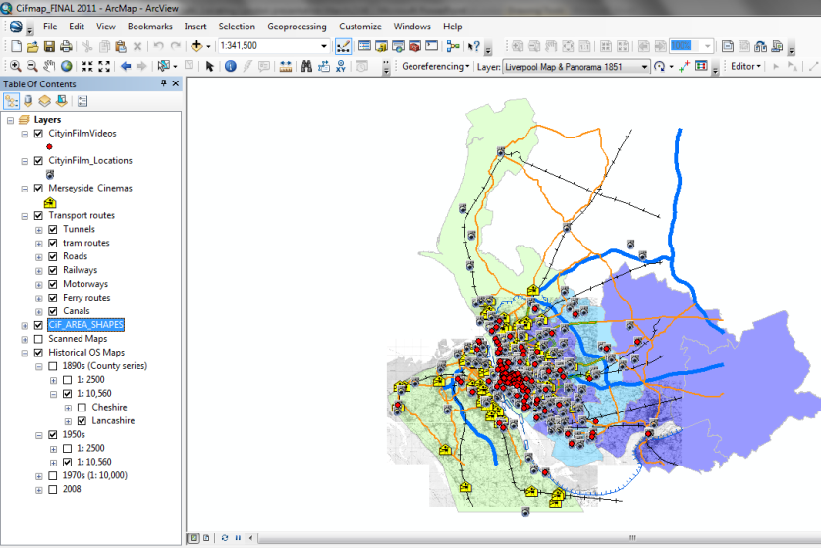
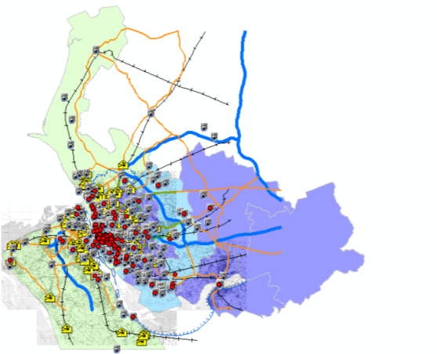
LOCATING THE ARCHIVE CITY
Mapping the City in Film: a Geo-Historical Analysis
(UK Arts and Humanities Research Council, 2008-2010)

Slide 14
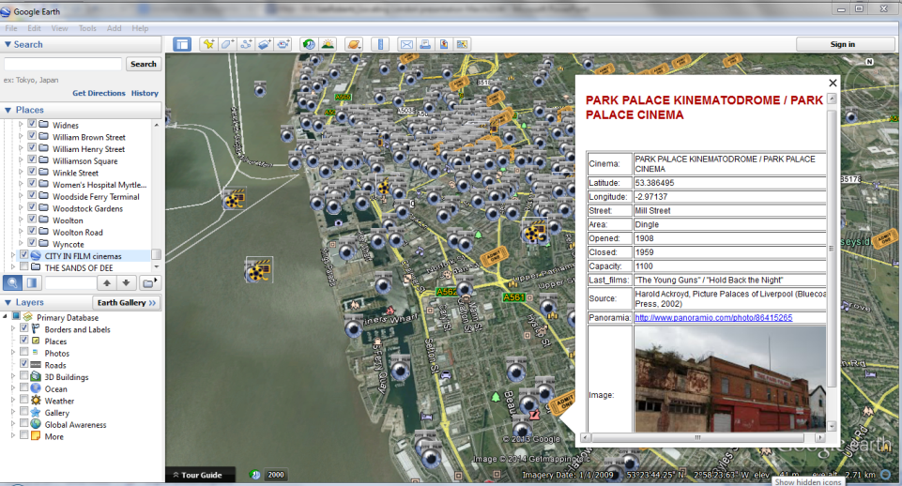
LOCATING THE ARCHIVE CITY
Mapping the City in Film: a Geo-Historical Analysis
(UK Arts and Humanities Research Council, 2008-2010)

Slide 15
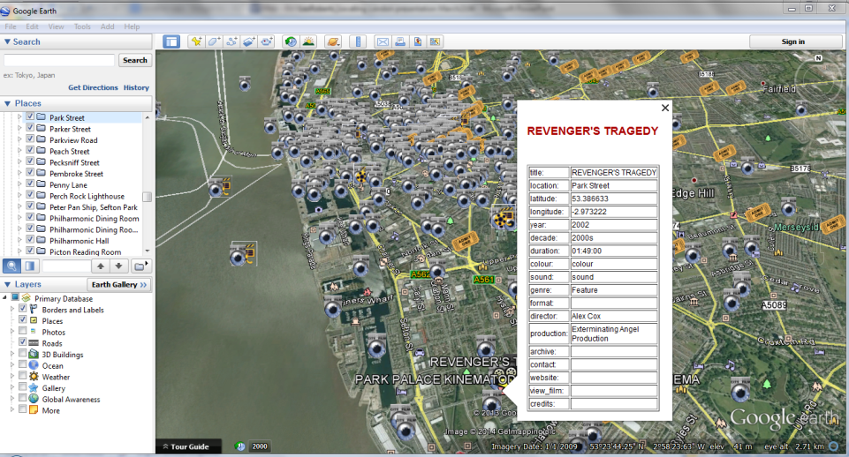
LOCATING THE ARCHIVE CITY
Mapping the City in Film: a Geo-Historical Analysis
(UK Arts and Humanities Research Council, 2008-2010)

Slide 16
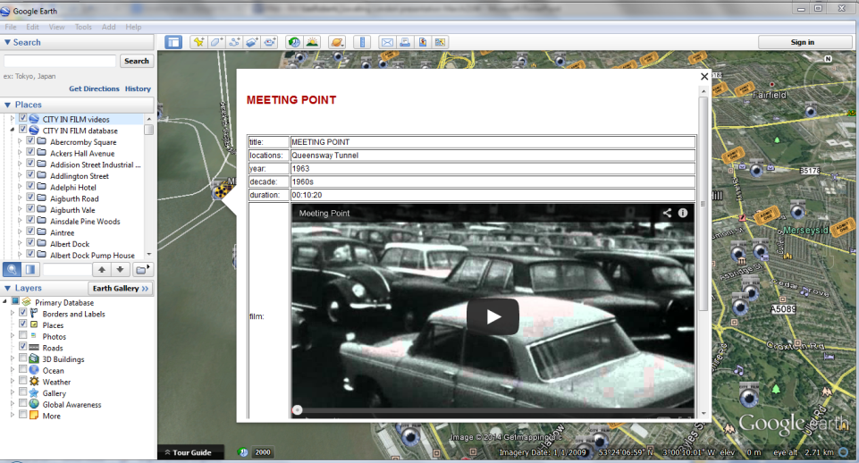
LOCATING THE ARCHIVE CITY
Mapping the City in Film: a Geo-Historical Analysis
(UK Arts and Humanities Research Council, 2008-2010)

Slide 17
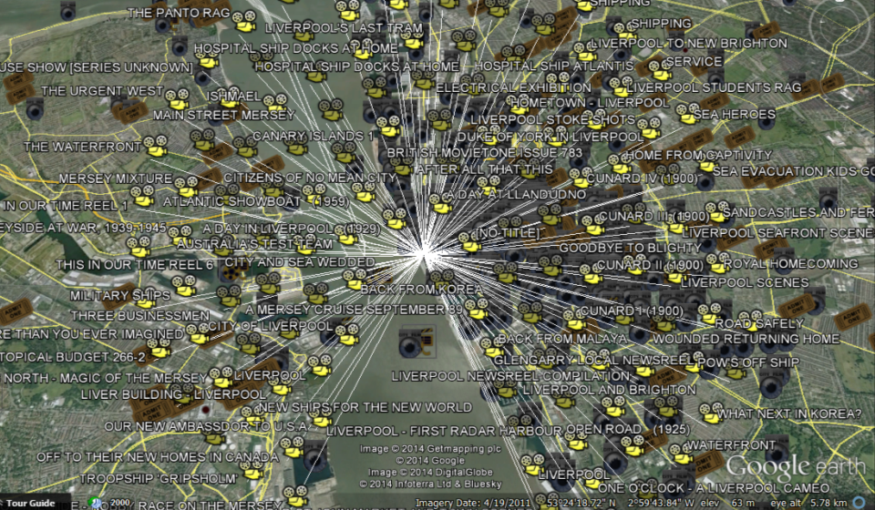
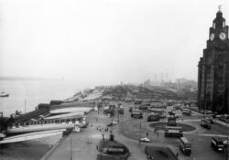
LOCATING THE ARCHIVE CITY
Mapping the City in Film: a Geo-Historical Analysis
(UK Arts and Humanities Research Council, 2008-2010)
Pier Head

Slide 18
SPATIAL HUMANITIES AND THE ARCHIVE CITY

Slide 19
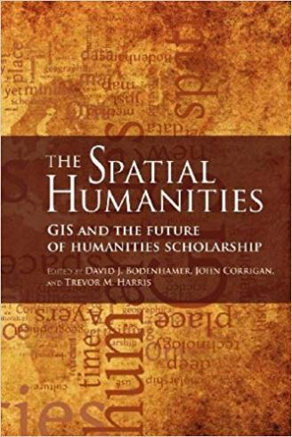
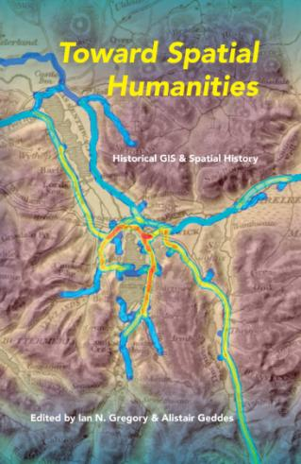
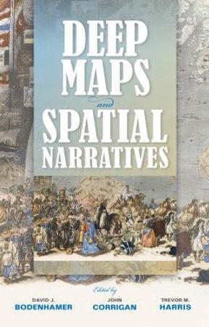
SPATIAL HUMANITIES AND THE ARCHIVE CITY

Slide 20
SPATIAL HUMANITIES AND THE ARCHIVE CITY
PUTTING THE ‘SPATIAL’ IN DIGITAL HUMANITIES
HISTORICAL GIS / QUALITATIVE GIS – incorporation of non-quantitative data within digital mapping platforms; geo-visualisation tools.
DIGITAL DEEP MAPPING –
“A deep map is a finally detailed, multimedia depiction of a place”
Bodenhamer, et al (eds.) (2015) Deep Maps and Spatial Narratives
Digital deep mapping “explores how digital tools and interfaces can support ambiguous, subjective, uncertain, imprecise, rich, experiential content alongside the highly structured data at which GIS systems excel”
A digital deep map is “a space in which a near limitless range and quantity of sources can be included, interrogated, manipulated, archived, analysed, and read”
Ridge et al. (2013) “Creating Deep Maps and Spatial Narratives through Design.” International Journal of Humanities and Arts Computing 7: 176–89.

Slide 21
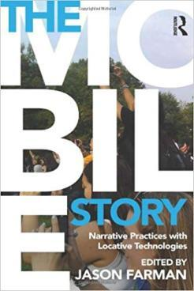
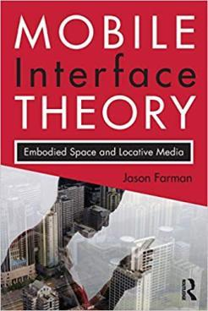
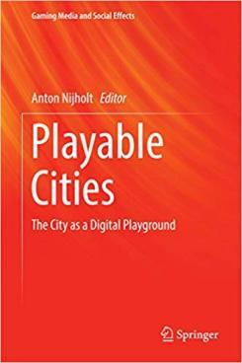
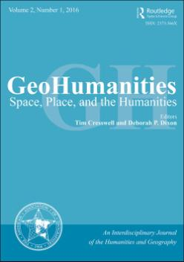
SPATIAL HUMANITIES AND THE ARCHIVE CITY
Embrace of digital media technologies in humanities research on space and place

Slide 22
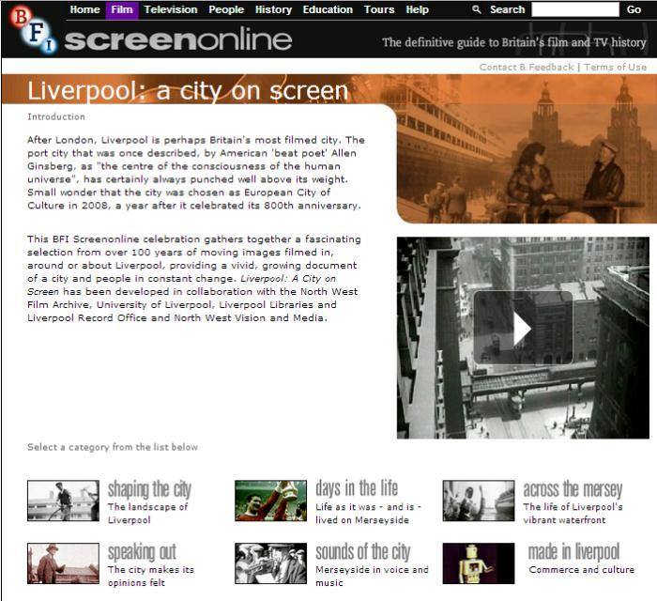
SPATIAL HUMANITIES AND THE ARCHIVE CITY
www.screenonline.org.uk/liverpool/

Slide 23
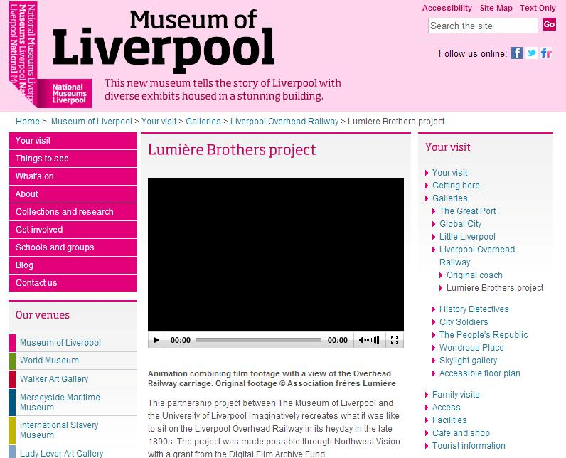
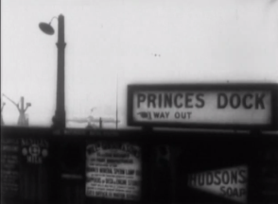
SPATIAL HUMANITIES AND THE ARCHIVE CITY
www.liverpoolmuseums.org.uk/mol/visit/galleries/overhead/lumiere.aspx

Slide 24
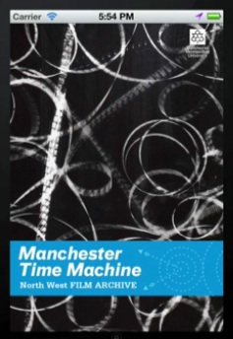
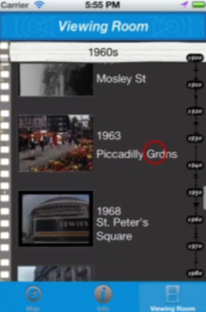
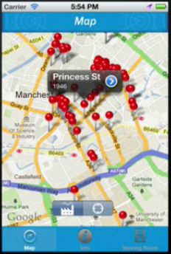
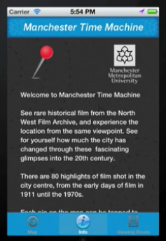
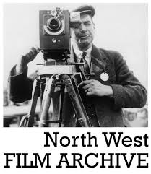
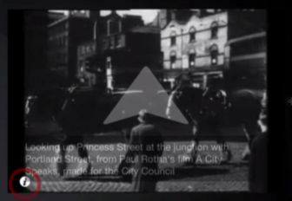
SPATIAL HUMANITIES AND THE ARCHIVE CITY
www.nwfa.mmu.ac.uk/mcrtimemachinev4.html

Slide 25
SPATIAL ANTHROPOLOGY AND THE ARCHIVE CITY

Slide 26
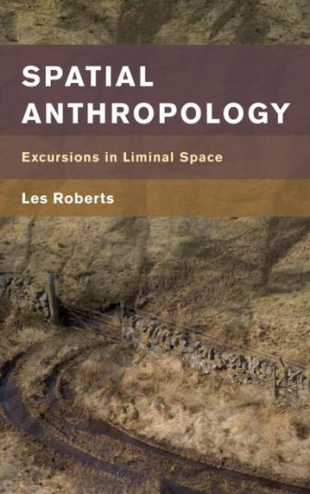
SPATIAL ANTHROPOLOGY AND THE ARCHIVE CITY
“the placing of oneself, critically and reflexively, within the space of contemporary landscapes (urban or otherwise), replete with the meanings and memories that are the accumulation of human activities”
[adapted from Jinnai Hidenobu, Tokyo: A Spatial Anthropology (1995); Roberts (2018) Spatial Anthropology: Excursions in Liminal Space]

Slide 27
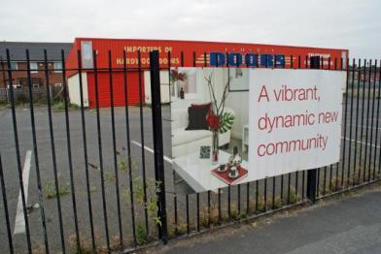
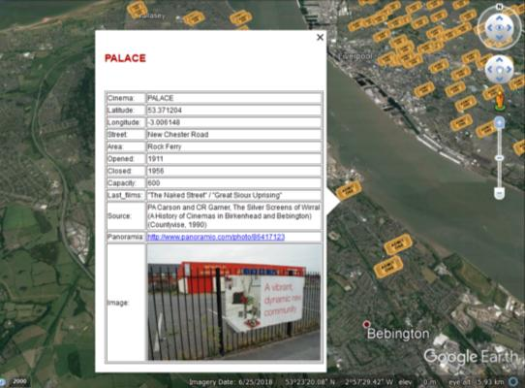
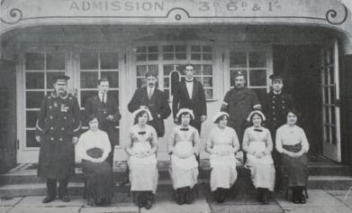
SPATIAL ANTHROPOLOGY AND THE ARCHIVE CITY
See: Les Roberts (2018) ‘Heterotopolis’, in Spatial Anthropology: Excursions in Liminal Space (Chapter 5).

Slide 28
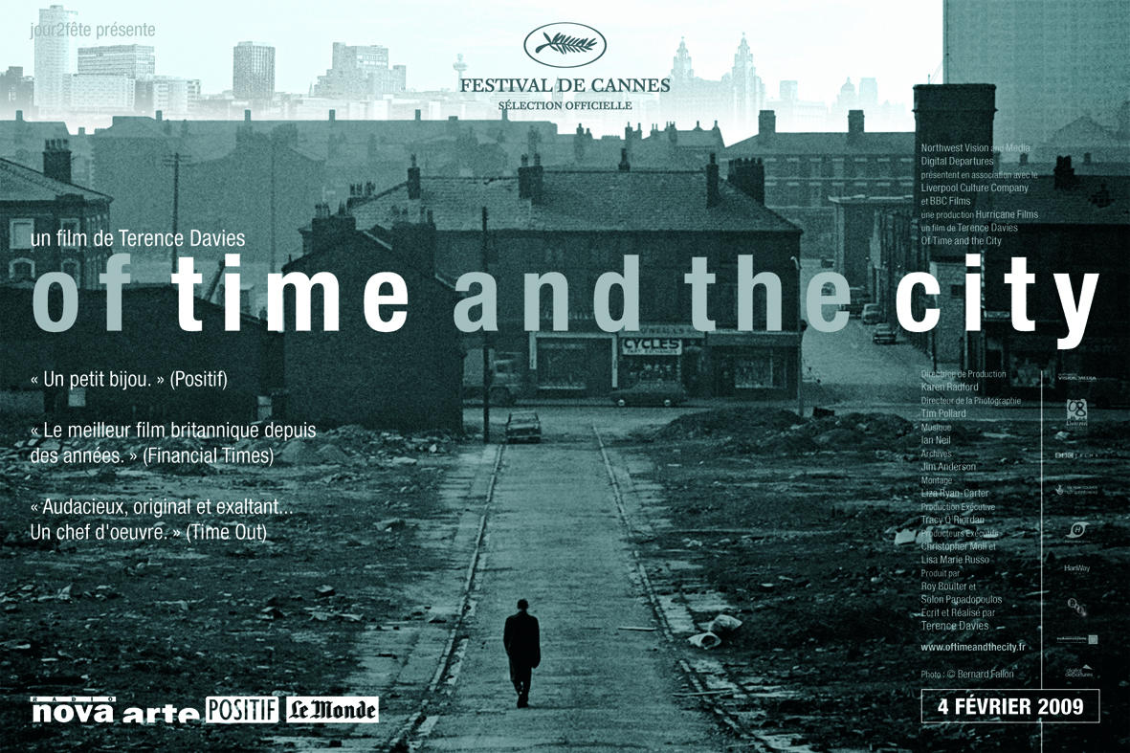
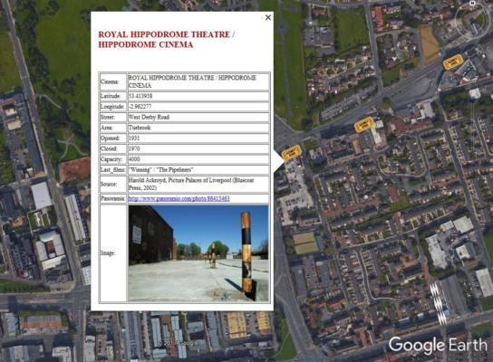
SPATIAL ANTHROPOLOGY AND THE ARCHIVE CITY
See: Les Roberts (2018) ‘Heterotopolis’, in Spatial Anthropology: Excursions in Liminal Space (Chapter 5).

Slide 29
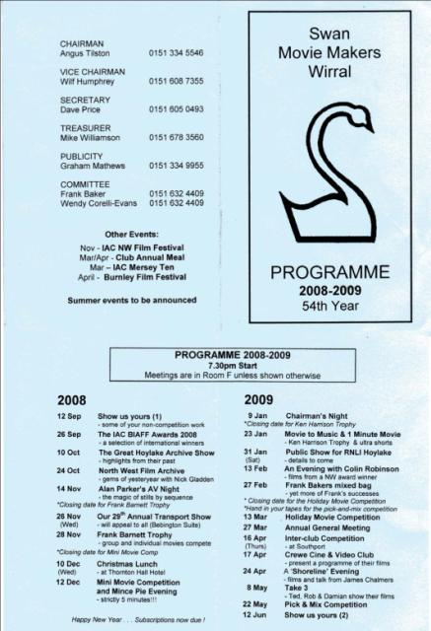
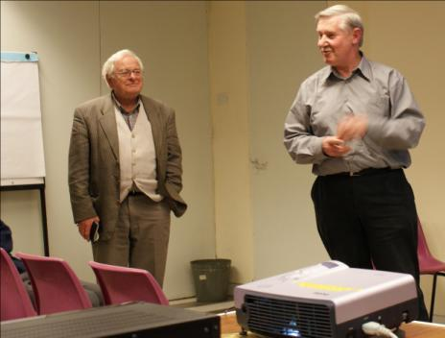
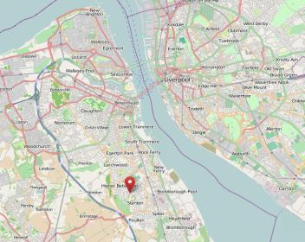
SPATIAL ANTHROPOLOGY AND THE ARCHIVE CITY

Slide 30
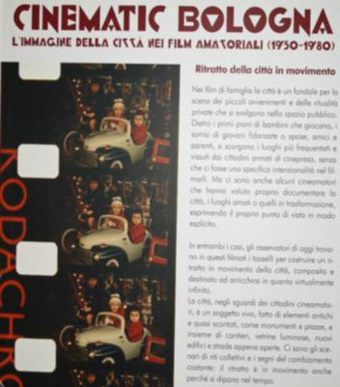
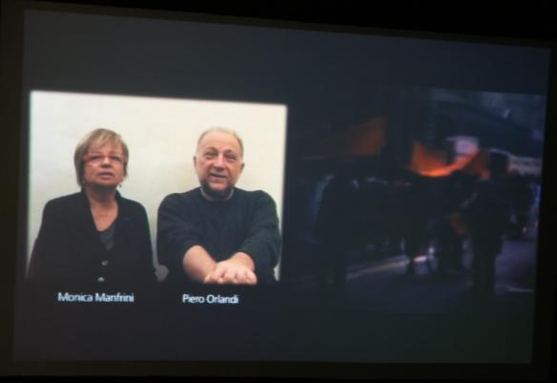
SPATIAL ANTHROPOLOGY AND THE ARCHIVE CITY

Slide 31
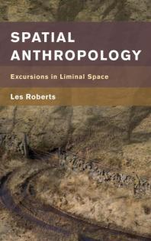
SPATIAL ANTHROPOLOGY AND THE ARCHIVE CITY
Whose city / whose memory / whose cultural heritage?
Habitus, place and identity
Cosmopolitanism and the archive city
Multiple and contested narratives – plurivocality
Socially and spatially embedded
Lived spaces - vernacular and everyday spatial stories
People as archives
Mapping spatial stories – mixed methods
Ethnography and qualitative
Oral history / social & cultural biography
Autoethnography
Performative and participatory
Archival (open, digital, database)
Archiveology (salvage, recycle, bricolage)
Cartography / deep mapping / GIS / locative media

Slide 32
NETWORKING THE ARCHIVE CITY

Slide 33
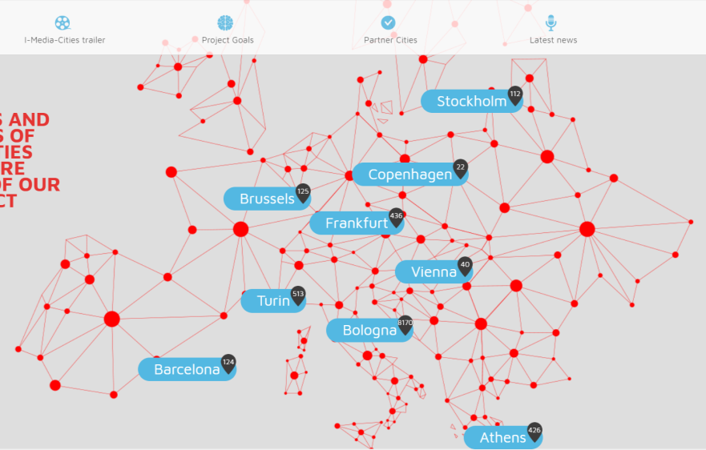
NETWORKING THE ARCHIVE CITY

Slide 34
NETWORKING THE ARCHIVE CITY
BUILDING THE CAPACITY FOR GROWTH
Can the archive city network expand?
Sustainability and after-project management
CAPACITY FOR DEVELOPING ‘ADD ONS’
Can the archival city resources be used to populate other digital applications? (e.g. locative media apps; city film tours/trails, etc.)
COMPATIBILITY BETWEEN PARTNER PROJECTS/CITIES
Software compatibility (database tools; imaging software; geospatial software systems)
Compatibility of aims and objectives across partners; to what extent is the remit underpinning the archival work shared across partner institutions and cities?
(Inter)disciplinary compatibility – are there disciplinary or epistemological fault lines evident between partner institutions?

Slide 35
NETWORKING THE ARCHIVE CITY
NEGOTIATING COPYRIGHT ON ARCHIVAL MATERIALS
To what extent can archive materials be made accessible in the public domain?
Can some archive material (e.g. amateur film/home movie footage) be negotiated easier than others?
What, if any, constraints are there in terms of image quality/resolution?
VALUING ARCHIVE CITIES AS INTANGIBLE CULTURAL HERITAGE
To what extent do archive cities inform and nourish everyday practices of urban social/cultural memory?
How does archival film heritage speak to authentic structures of meaning and identity in cities today?
Can archive cities be valued as anthropological resources?
Can the archive city network inform a wider understanding of, and engagement with, the spatial anthropology of cities?

Slide 36
References cited in presentation
Bodenhamer DJ, J Corrigan and TM Harris (eds) 2015. Deep Maps and Spatial Narratives. Bloomington: Indiana University Press.
Bodenhamer DJ, J Corrigan and TM Harris (eds.). 2010. The Spatial Humanities: GIS and the Future of Humanities Scholarship. Bloomington: Indiana University Press.
Cresswell, T and D Dixon. GeoHumanities: Space, Place and the Humanities. Journal.
Farman, J. (ed.) 2014. The Mobile Story: Narrative Practices with Locative Technologies. Abingdon: Routledge.
Farman, J. 2012. Mobile Interface Theory: Embodied Space and Locative Media. Abingdon: Routledge.
Gehl, R. 2009. ‘YouTube as archive: Who will curate this digital Wunderkammer?’ in International Journal of Cultural Studies, 12 (1): 43-60.
Gregory, I and A Geddes (eds) 2014. Towards Spatial Humanities: Historical GIS and Spatial History. Bloomington: Indiana University Press.
Hallam, J and L Roberts (eds.) 2014. Locating the Moving Image: New Approaches to Film and Place. Bloomington: Indiana University Press.
Hidenobu, J. 1995. Tokyo: A Spatial Anthropology. Berkeley: University of California Press.
Lefebvre, Henri. 1991. The Production of Space. Oxford: Blackwell.
Nijholt, A. 2016. Playable Cities: The City as a Digital Playground. Singapore: Springer.
Ridge, M, D Lafreniere and S Nesbit. 2013. “Creating Deep Maps and Spatial Narratives Through Design.” International Journal of Humanities and Arts Computing 7: 176-189.
Roberts, L. (ed) 2015-16. ‘Deep Mapping’, Special Issue of Humanities, 4 and 5: www.mdpi.com/journal/humanities/special_issues/DeepMapping
Roberts, L. (ed) 2017-18. ‘Spatial Bricolage’, Special Issue of Humanities 6 and 7: www.mdpi.com/journal/humanities/special_issues/spatial_bricolage
Roberts, L. 2015. ‘Navigating the “Archive City”: Digital Spatial Humanities and Archival Film Practice’, in Convergence: The International Journal of Research into New Media Technologies, 21 (1): 100-115.
Roberts, L. 2018. Spatial Anthropology: Excursions in Liminal Space. London; Rowman & Littlefield.
Roberts, L. 2012. Film, Mobility and Urban Space: a Cinematic Geography of Liverpool. Liverpool University Press.
Russell, C. 1999. Experimental Ethnography: The Work of Film in the Age of Video. Durham and London: Duke University Press.
Russell, C. 2017. ‘What is Archiveology’? in The International Association for Media and History, 16 May 2017, http://iamhist.net/2017/05/archiveology/
Sheringham, M. 2010. ‘Archiving’, in M. Beaumont and G. Dart (eds.), Restless Cities, London: Verso.

Slide 37
Publications
For list of books please see:
http://liminoids.com/books/index.html
For list of articles and book chapters:
http://liminoids.com/articles/index.html
THANK YOU
Les Roberts
School of the Arts
University of Liverpool
les.roberts@liverpool.ac.uk
liminoids.com

